Slide 1
Templates and Exception Handling in C++
Unit-5

Slide 2
Contents:
1. Templates
Generic Functions
Generic Classes
2. Exception Handling

Slide 3
Templates
Generic Functions and
Generic classes

Slide 4
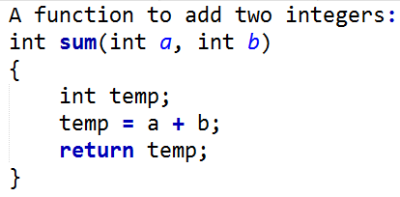
Generic Functions / Function Template
To understand the concept of generic function, let us first understand the following example:
Above function is a simple function to add two integers. Now consider a function to add two floats, two double…

Slide 5
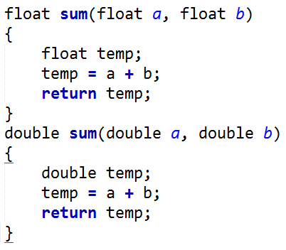
It is clear by now that the above functions have the same functionality ie., to add variables, the difference is on the type of data that they operate upon.

Slide 6
From these example, the approach of writing different function bodies would suffer from the following disadvantages:
Rewriting the same function body over and over for different data types.
The program would consume more space on the hard disk.
It would be nice if we could write a function just once and make it work for many different data type.
It is possible in C++ by using the concept of generic functions.

Slide 7
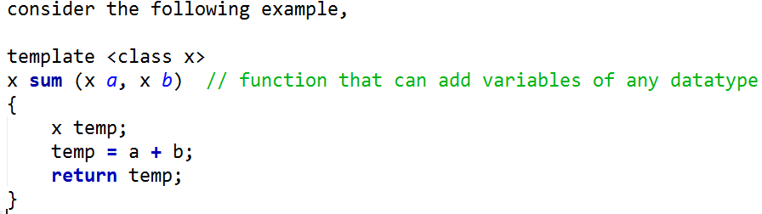
In the above example, specific data types such as int, float, etc., have not been used. Rather a generic data type ‘x’ has been created (using template <class x> ) and has been used in the function.
Generic data type ‘ x ’ can take on any specific value (such as int, float, double, char, etc. ) depending upon the function call.

Slide 8
Syntax :
template <class generic_type>
return_type function_name(parameter list)
{
- -;
- -;
}
Now let us understand a complete program that makes use of the concept of generic functions for adding two variables.
(refer b.cpp)

Slide 9
Generic Class or Class template
Similar to generic functions, we can also create generic classes. Such classes are also called as template classes.
The general syntax for creating generic class is as follows:
template <class generic_type>
class name
{
----
----
};

Slide 10
Exception Handling in C++

Slide 11
Exception handling fundamentals
Exceptions are the errors that occur at run time.
There are several reasons for occurrence of exception:
Shortage of memory
Inability of open a file
Exceeding the range of an array
Attempt to initialize an impossible value to an object, etc.
In such situation, the programmer has to resolve it, he may choose to display an error message on screen, or request the user to input better or proper data or simply terminate the program.

Slide 12
.
C++ provides a systematic approach for handling run-time error i.e., exception handling.
The exception handling mechanism uses three keywords try, throw and catch.
The program statements to be monitored for exceptions are included in try block
The necessary actions to be taken when exception occurs are enclosed in catch block.
When the exception occurs, informing the catch block about the exception is known as throwing an exception.
Thus , the errors occurred in try block are thrown and are caught by catch block.

Slide 13
Syntax:
try
{
//try block statements
throw exception
}
catch (type1 arg)
{
//catch block statements;
}
.
.
.
catch(typeN arg)
{
//catch block statements;
}

Slide 14
Rules for exception handling
1. There must be a match in the data type of exception thrown and data type specified in catch block.
2. A single try block can have multiple catch blocks.
3. There is generic catch available which can catch all types of exceptions.
syntax of such a catch is : catch(…){ }
4. In C++ and exception can be re-thrown. (refer ex9.cpp)
5 . Restricting exception (refer ex10.cpp)
Eg: void divide(int a, int b) throw (int, char, double)
6. Catching class type exception (refer ex11.cpp)
7 . Handling derived class exception. (refer ex12.cpp)

Slide 15
Constructors and destructor in exception handling
Constructors are implicitly invoked when object created.
Suppose constructor and destructor are used in try block, when objected created then constructor is invoked implicitly. And normally destructors are invoked before closing of that block.
Suppose if we use throw statement soon after the object creation (constructor). What happens?
normally, when the control executes the throw statement immediately it will be catched by the catch block.
Then when the destructor gets invoked?
For example: (refer ex6.cpp)

Slide 16
Whenever there is a constructor and destructor in a class and object of that class is created in a try block, and when an exception thrown, the control before going to reach the catch block, destructor gets executed automatically.

Slide 17
Some more references on Exception Handling

Slide 18
Terminate()
Function handling termination on exception Calls the current terminate handler.
By default, the terminate handler calls abort. But this behavior can be redefined by calling set_terminate.
This function is automatically called when no catch handler can be found for a thrown exception, or for some other exceptional circumstance that makes impossible to continue the exception handling process.
This function is provided so that the terminate handler can be explicitly called by a program that needs to abnormally terminate, and works even if set_terminate has not been used to set a custom terminate handler (calling abort in this case).
Return value none (the function never returns).

Slide 19
Unexpected()
Function handling unexpected exceptions
Calls the current unexpected handler.
By default, the unexpected handler calls terminate. But this behavior can be redefined by calling set_unexpected.
This function is automatically called when a function throws an exception that is not listed in its dynamic-exception-specifier (i.e., in its throw specifier).
This function is provided so that the unexpected handler can be explicitly called by a program, and works even if set_unexpected has not been used to set a custom unexpected handler (calling terminate in this case).
Return value none

Slide 20
Set unexpected handler function
Sets f as the unexpected handler function.
The unexpected handler function is a function automatically called when a function throws an exception that is not in its dynamic-exception-specification (i.e., in its throw specifier).
The unexpected handler function can handle the exception and shall end either by teminating (calling terminate or some other method, such as exit or abort) or by throwing an exception (even rethrowing the same exception again). If the exception thrown (or rethrown) is not in the function's dynamic-exception-specification but bad_exception is, a bad_exception is thrown. Otherwise, if the new exception is not in the dynamic-exception-specification either, terminate is automatically called.
Before this function is called by the program for the first time, the default behavior is to call terminate.

Slide 21
Uncaught()
Uncaught exceptions:
In the past few examples, there are quite a few cases where a function assumes its caller (or another function somewhere up the call stack) will handle the exception.
In the following example, mySqrt() assumes someone will handle the exception that it throws -- but what happens if nobody actually does?
Here’s our square root program again, minus the try block in main():

Slide 22
End of Unit 5

